Slide 1

Computer Organization 2
Lab tutorial 1
Chapter (1)

Slide 2
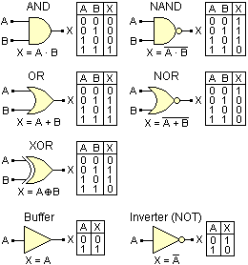
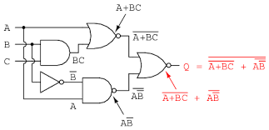
Logic Gates
Logic Gates
The Inverter
The AND Gate
The OR Gate
The NAND Gate
The NOR Gate
The XOR Gate
The XNOR Gate
The Buffer Gate
Drawing Logic Circuit
Analysing Logic Circuit

Slide 3
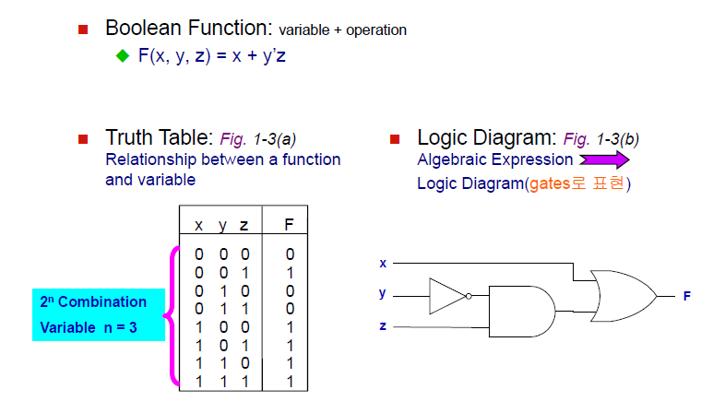
Boolean Algebra

Slide 4
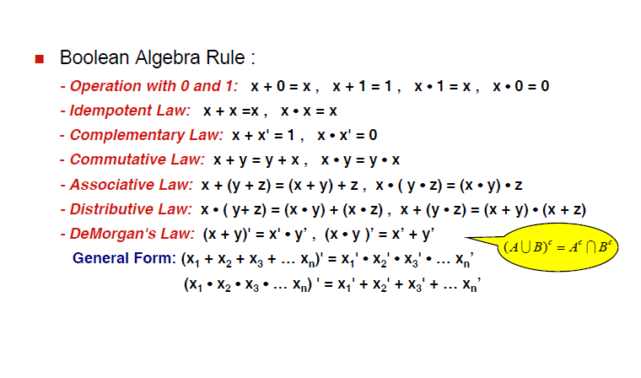
Boolean Algebra Rule

Slide 5
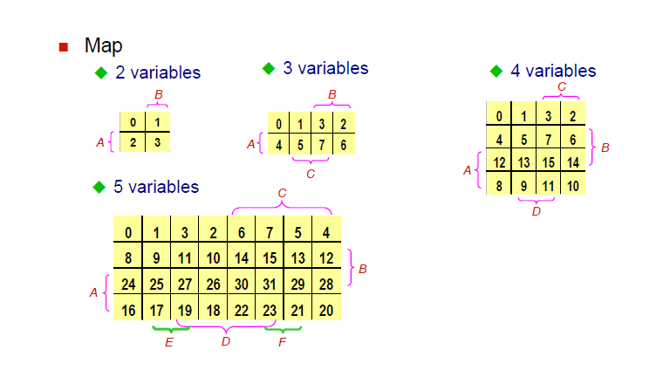
Map Simplification

Slide 6
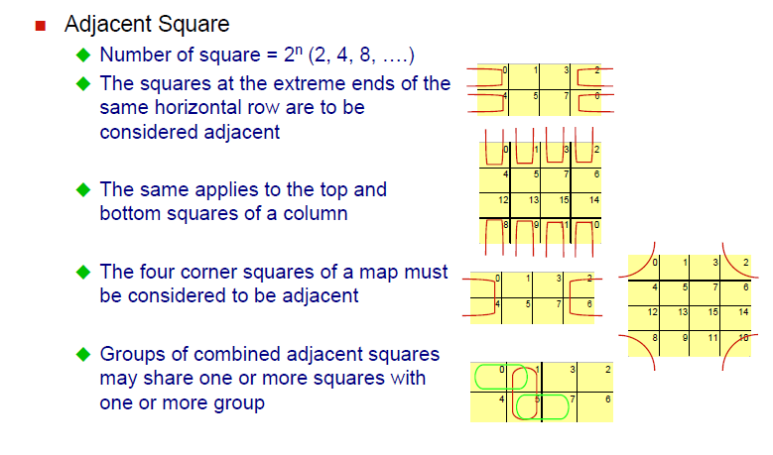
Map Simplification

Slide 7
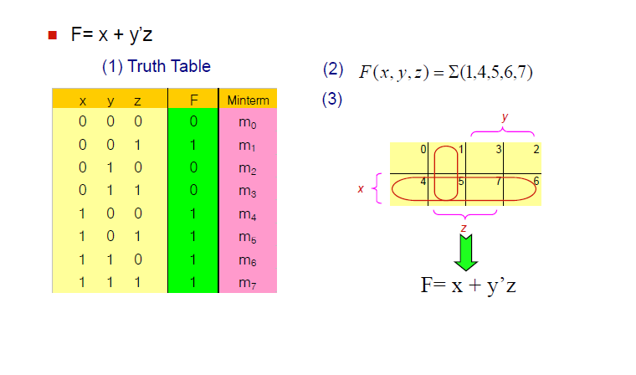
Map Simplification

Slide 8
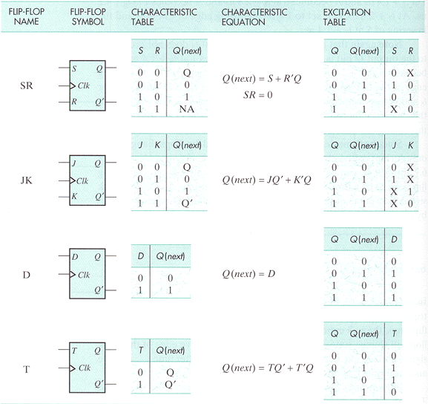
Flip-Flops

Slide 9

Problems

Slide 10


Slide 11
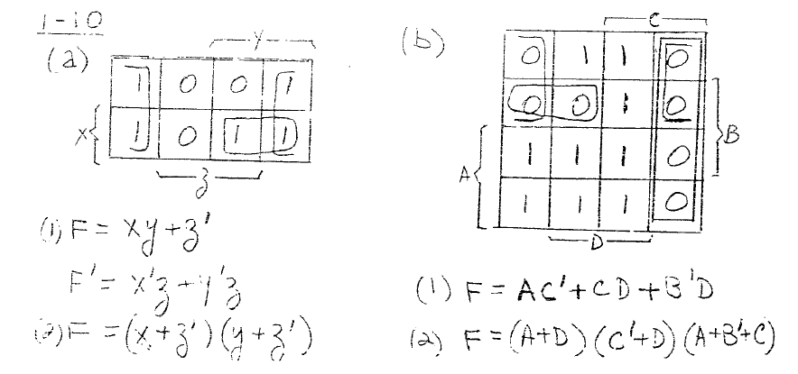

Slide 12
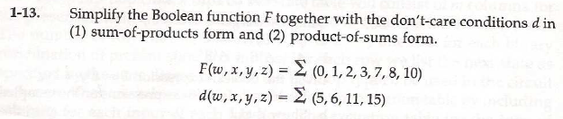

Slide 13
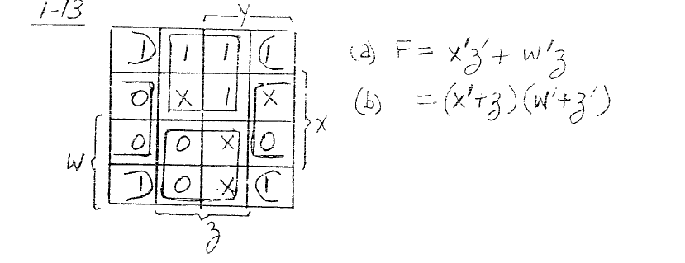

Slide 14
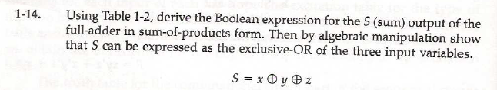
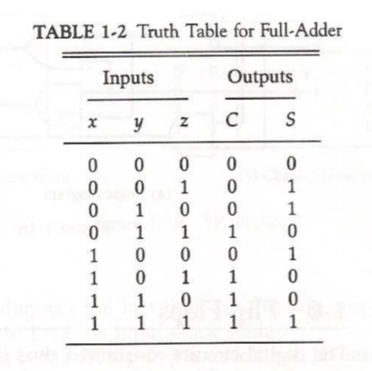

Slide 15
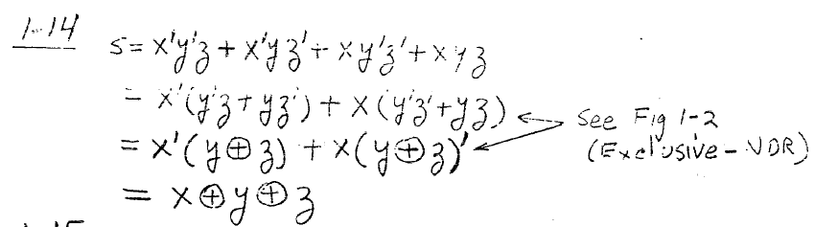

Slide 17
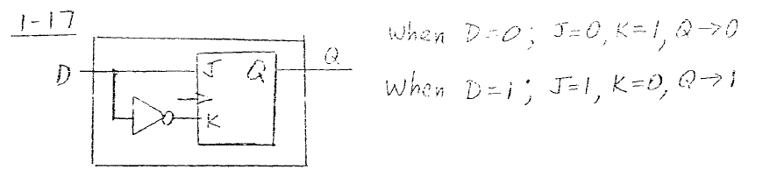

Slide 18
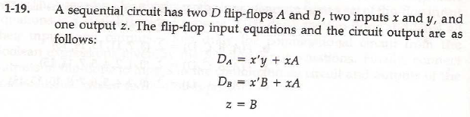


Slide 19
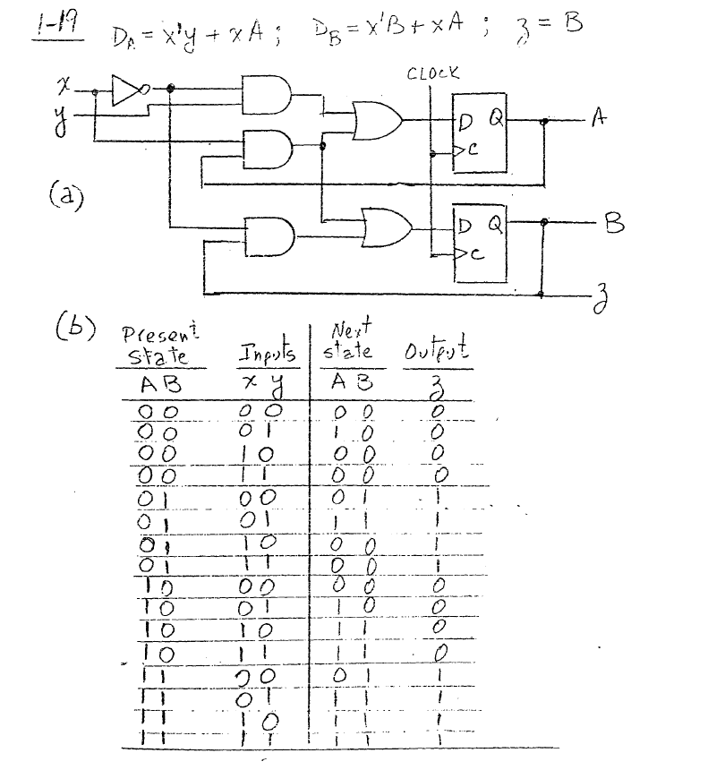

Slide 20
Thanks

